Slide 1
Sewage Sludge Economic Analysis
Alex Badgett, Emily Newes, Anelia Milbrandt
DRAFT – DO NOT CITE/DISTRIBUTE
November 1, 2017

Slide 2
Modeling Overview

Slide 3
Objectives
Characterize costs associated with treating and disposing of sewage sludge in the U.S.
Develop model that covers regional variability in sludge disposal alternatives
Model costs at different sized Publicly Owned Treatment Works (POTWs)
Create and analyze sewage sludge supply curves at national and regional levels
Run as-needed WTE model scenarios
DRAFT – DO NOT CITE/DISTRIBUTE

Slide 4
Model Structure
Long Term Storage
Primary & Secondary Treatment
Class A Biosolids
Dewatering
Hauling
Landfill
Storage
Land Application
Sunk Costs
Incineration
Added Costs
Avoided Costs
Model assumes that WTE technology is developed on-site at POTW
DRAFT – DO NOT CITE/DISTRIBUTE

Slide 5
National Sludge Supply Curves
Differentiates supply curves for POTWs by daily plant inflow
Green curve suggests that large amounts of sludge are available at a fewer (less distributed) number of POTWs
Both curves model sludge as a negative cost WTE feedstock
DRAFT – DO NOT CITE/DISTRIBUTE

Slide 6
Areas of Further Analysis

Slide 7
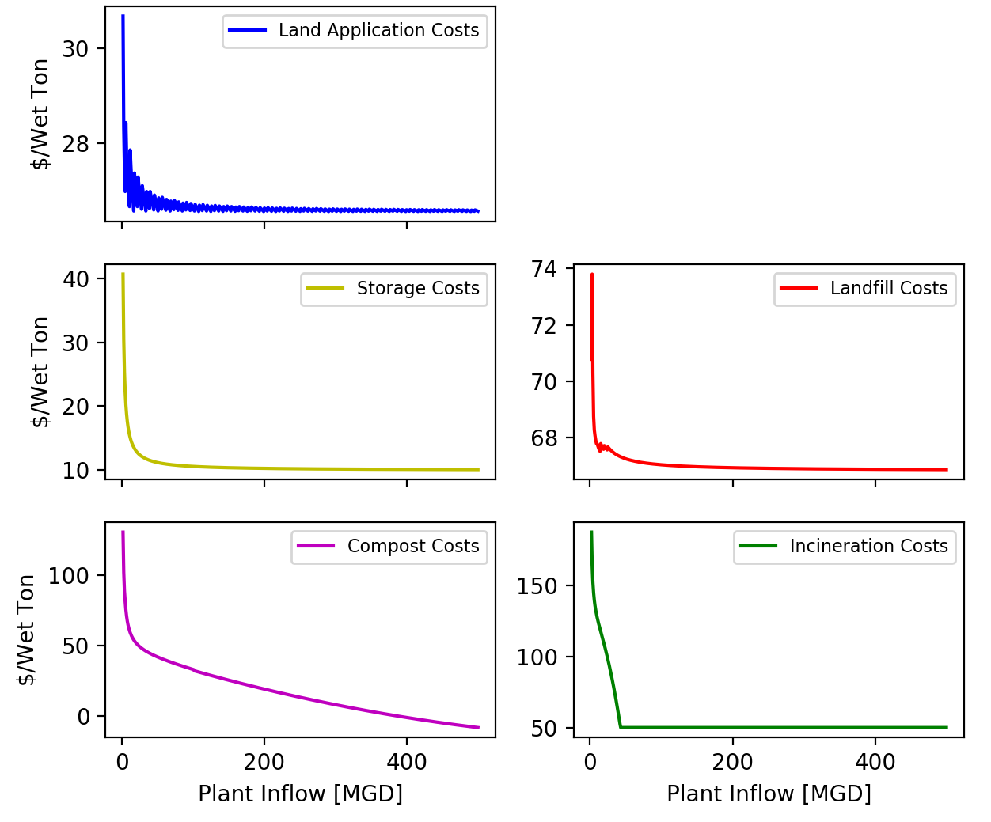
Modeled Disposal Costs
Cost per wet ton determined with 1985 EPA cost curves¹ for different sludge disposal alternatives
Updated for inflation
Need to understand how these cost curves apply to modern POTW costs
Lacking real world data to calibrate model results
¹EPA, “Handbook: Estimating Sludge Management Costs,” United States Environmental Protection Agency, 1985.
DRAFT – DO NOT CITE/DISTRIBUTE

Slide 8
Cost of Sludge Disposal Alternatives
POTW Size | Ag Land Application | Landfill | Incineration | Class A Biosolids | Long Term Storage
>10 and <50 MGD | $27.17 | $54.74 | $96.81 | $41.49 | $6.29
>50 MGD | $26.90 | $68.29 | $50.00 | $29.66 | $3.71
No available data to validate the model average cost per wet ton shown above
Need a recent source for baseline cost estimation to validate our results with
DRAFT – DO NOT CITE/DISTRIBUTE

Slide 9
Sludge Disposal Alternatives
Prevalent sludge disposal option modeled by state
North East Biosolids and Residuals Association (NEBRA) survey data used to find the most likely disposal alternative²
National disposal alternative distribution as shown
²NEBRA, “A National Biosolids Regulation, Quality, End Use & Disposal Survey,” North East Biosolids and Residuals Association (NEBRA), 2007.
DRAFT – DO NOT CITE/DISTRIBUTE

Slide 10
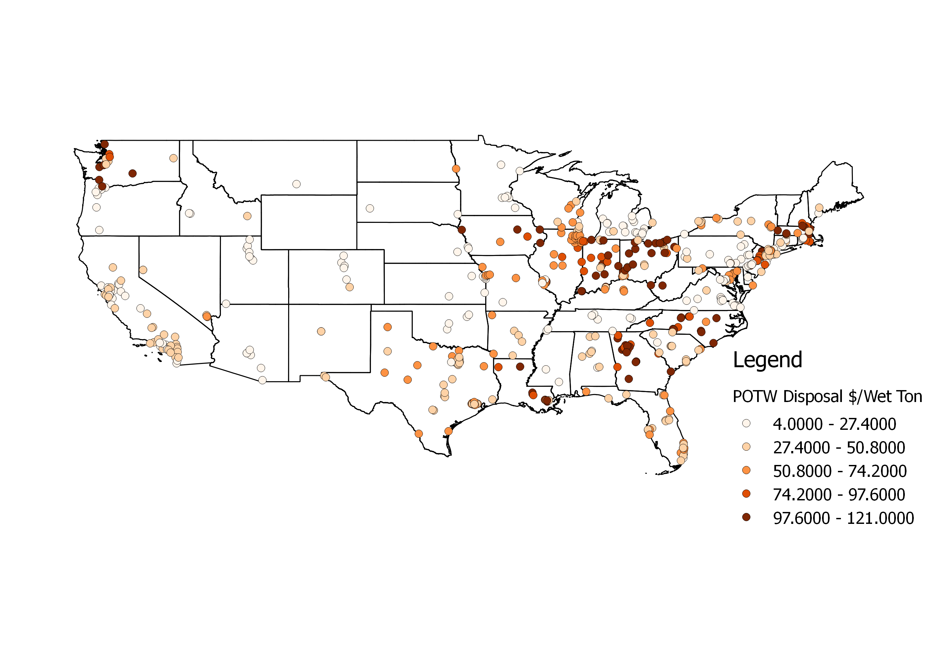
Geospatial Disposal Cost
DRAFT – DO NOT CITE/DISTRIBUTE

Slide 11
Dewatering and Storage
Dewatering and storage are likely needed for sludge use as a WTE feedstock
Some POTWs already incorporate one or both, making them sunk costs
Their use varies regionally, however no known data exists to incorporate their cost into our modeling
DRAFT – DO NOT CITE/DISTRIBUTE

Slide 12
Dewatering and Storage National Supply Curves
DRAFT – DO NOT CITE/DISTRIBUTE

Slide 13
Thank you!

